Slide 1
Data-Driven Partnerships to Strengthen Workforce Readiness
Allison Forbes PhD, Center for Regional Economic Competitiveness (CREC)
March 31, 2026, presentation at DMC Session "Defense Manufacturing Workforce Strategy of the Future: Integrating Talent & Technology Data"
Distribution Statement A

Slide 2
Approved for Public Release, Distribution Unlimited
Distribution Statement A

Slide 3
The Partnership Model
A defense manufacturing workforce strategy that actively engages partners who know their regions best
KEY PARTNERS
Employers
Economic Development Orgs
Community Colleges
Workforce Boards
Support Centers for Small Manufacturers
Define needs, validate skills, and drive hiring demand
Bridge industry needs and public investment resources
Align curricula to employer-validated competency needs
Connect job seekers and funding to defense manufacturing pathways
Trusted on-the-ground advisors for manufacturers of all sizes
Distribution Statement A
Notes:
Talk about STATE and LOCAL
LARGE and SMALL employers
Manufacturing-specific industry associations
Partnerships translate national workforce policy into local impact by engaging with manufacturers and their communities to meet the workforce needs of local employers

Slide 4
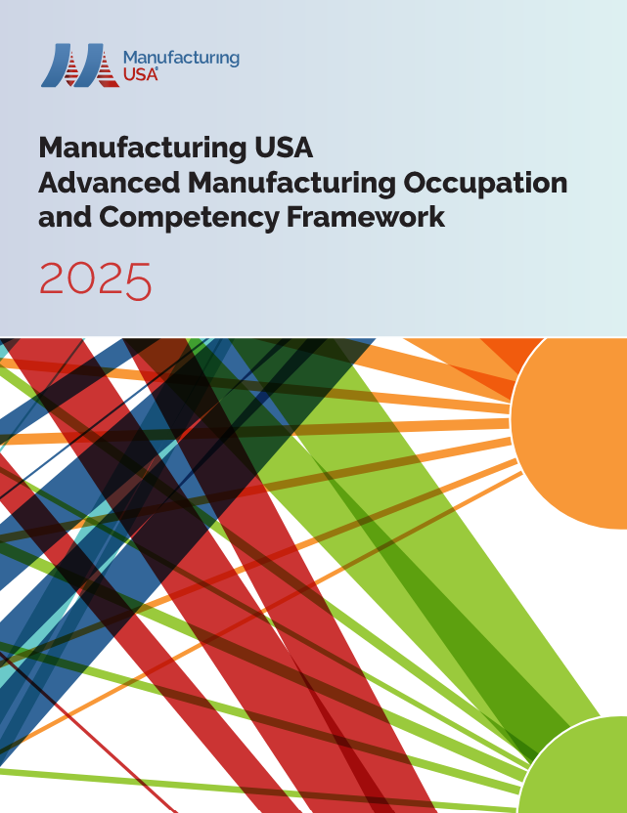
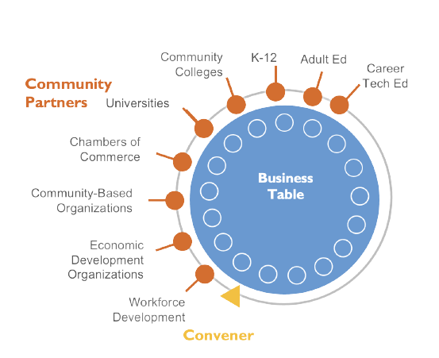
A Common Language for Skill Gaps
Using the Framework as a Common Language…
…to Answer Critical Questions…
…to Continuously Improve Training Programs
Which skill clusters are most in-demand in our region now and in the future?
Are talent pipelines aligned with anticipated hiring/skill requirements?
Which training programs address current and future defense manufacturer needs?
Where can talent fuel growth and innovation?
Distribution Statement A
Notes:
AF NOTE: the challenge is supporting SMMs and meeting defense targets for skill development
Using the Framework as a Common Language…
The Competency Framework gives every employer and partner the same vocabulary for describing skills, roles, and gaps — removing the guesswork from local conversations.
A shared language makes it possible to compare needs across firms, sectors, and regions.
…MIIs Can Help to Convene Local Companies…
Bring together firms across a region using shared framework language
Identify patterns in skill shortages that no single company sees alone
Build consensus around community-wide priorities for action
Aggregate demand signals to advocate for targeted training investment
…to Answer Critical Workforce Questions…
Which skill clusters are most in-demand in our region right now?
Where are the gaps between our talent pipelines and near-term hiring needs?
Which training programs are aligned — and which need to be built?
Where is innovation happening and is talent keeping pace?

Slide 5
Relevant to Small & Mid-Sized Manufacturers
~75%
of manufacturing companies have 20 employees or less
41%
of manufacturing employees
work in small- and medium-sized companies (500 employees or less)
Source: U.S. Census Bureau
Distribution Statement A
Notes:
…with a Special Focus on Small & Mid-Sized Manufacturers
Smaller firms often lack workforce planning capacity. Aggregated regional data helps them see and act on trends they couldn’t track alone.
Siting and scaling decisions informed by regional talent supply
Shared advocacy for programs that serve the whole community
A replicable model for growth within the defense industrial base

Slide 6
Data to Drive Local Action
Regional Workforce Insights position education and training providers
to deliver programs needed by the defense industrial base.
TARGET PROGRAMS
College Coursework & Credentials
Workforce Training
Apprenticeship Pathways
Align credit and non-credit curricula to employer-validated competency needs
Upskill incumbent workers and new entrants in technical and foundational skills
Build earn-and-learn pathways that connect talent directly to advanced manufacturing careers
Distribution Statement A

Slide 7
Strategy to Strengthen Workforce Readiness
Assess Employer Needs
Define Shared Language (Competency Framework)
Convene Employers and Partners
Deploy Targeted Training
Strengthen Defense Workforce Readiness
Distribution Statement A

Slide 8
Playbook for Your Region
Four steps any region can take to connect talent development to defense manufacturing
1
Connect Talent Development to National Security Goals
2
Use the Competency Framework as Common Language
A resilient defense industrial base depends on a skilled workforce — this model gives regions the tools to build it.
■ Workforce readiness as a national security imperative
■ Replicable regional model for the defense industrial base
Convene local companies around shared skill definitions to surface community-wide gaps no individual firm can address alone.
■ Standardize vocabulary across roles and sectors
■ Identify transferable skill clusters across the region
■ Build consensus on community-wide training priorities
3
Partner with Regional Anchors
4
Advocate for Targeted Training Investment
Engage economic development entities, MEPs, larger employers, and industry forums — they are your force multipliers on the ground.
■ Economic development organizations
■ Workforce boards and industry forums
■ Support centers for SMMs
Use aggregated employer data to identify or build programs that serve defense manufacturing needs.
■ Community college programs and apprenticeships
■ Curricula aligned with skill gaps validated by employers
Distribution Statement A

Slide 9
Additional Resources for Defense Manufacturing Workforce Development
1
2
3
Regional Workforce Insights and Reports
State Asset Maps, Funding Opportunities, Applied Research
Defense-Specific Scenarios for Activating Workforce Systems
Distribution Statement A

Slide 10
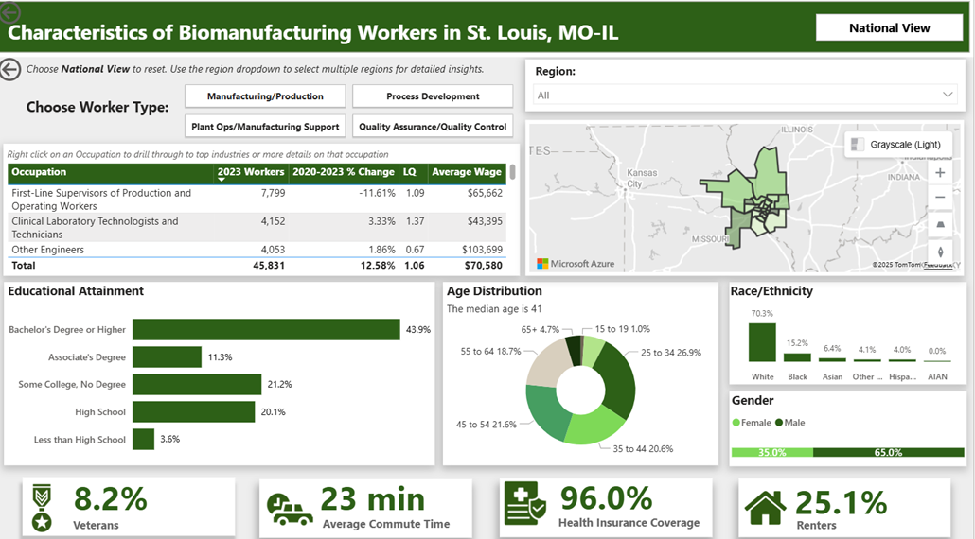
Regional Workforce Insights
Distribution Statement A

Slide 11
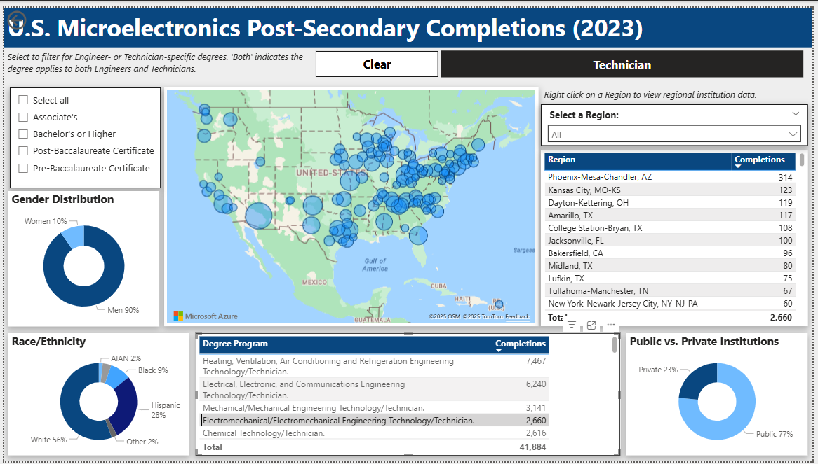
Regional Workforce Insights
Distribution Statement A

Slide 12
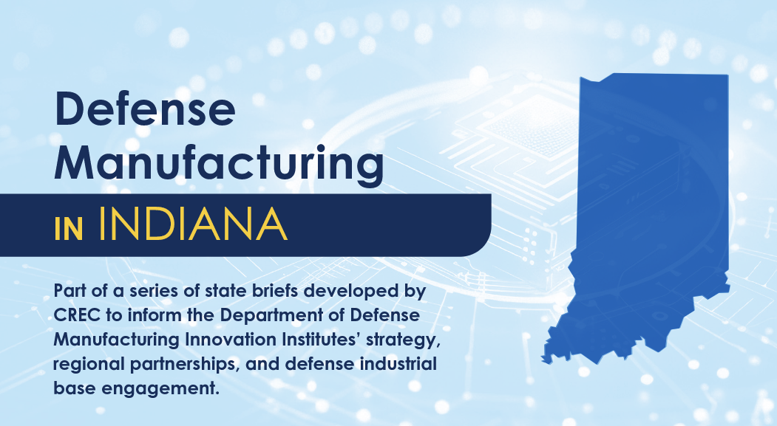
State-Level Defense Manufacturing Intelligence Briefs
States Intelligence Briefs Include:
Available Assets for Partnership
State’s Capabilities in Critical Technology Areas
Defense-Related Workforce and Training Pipelines
Pilot and Scaling Opportunities
Distribution Statement A

Slide 13
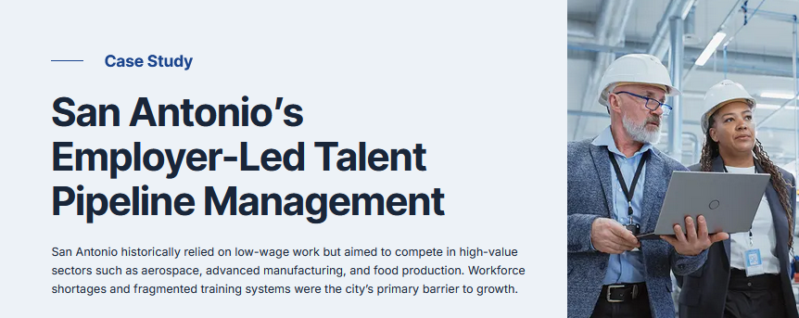
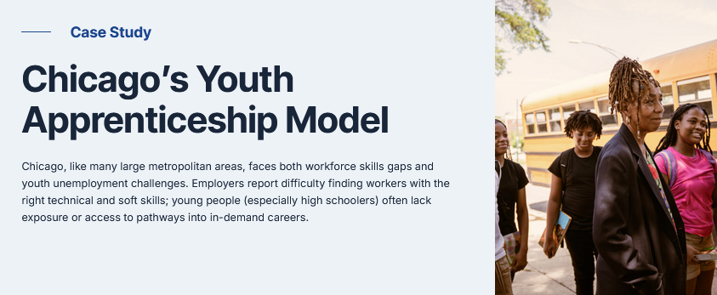
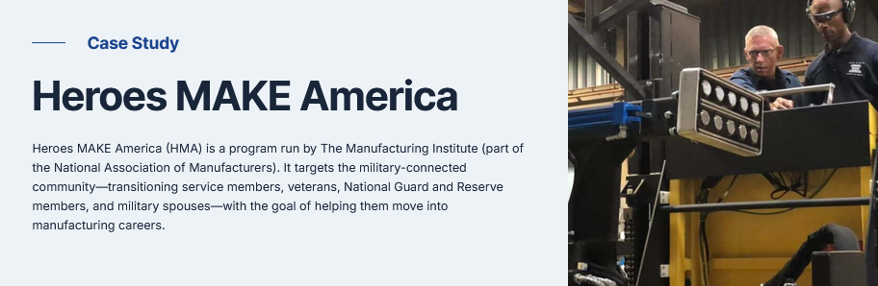
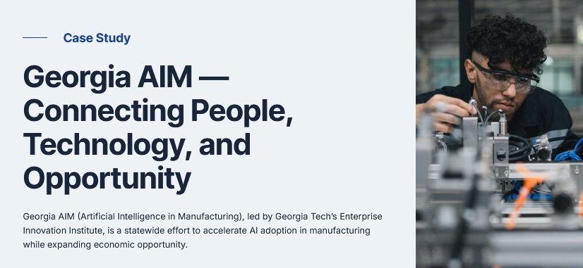
Case Studies on Regional Manufacturing Workforce Development
Distribution Statement A

Slide 14
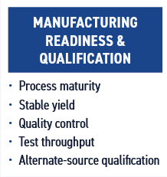
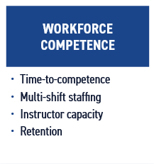
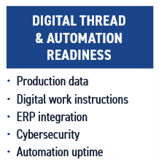
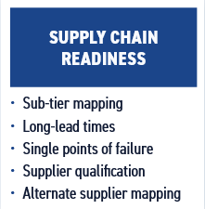
Surge Capacity Analysis and Case Studies
Investigating the Role of Workforce and Tech Adoption in a Surge Production Scenario
An effective surge strategy must treat workforce and technology
adoption as a single, integrated problem
Case Studies on Surge Production
1
A Tale of Two Factories: Surging 155mm Artillery Round Production
2
Comparative Assessment of the Replicator Initiative and Ukraine’s Brave1 Platform
3
Workforce Scaling at Anduril’s Arsenal-1 Hyperscale Manufacturing Facility
4
Building the Supply Chain Infrastructure for Crisis Response: America Makes’ Advanced Manufacturing Crisis Production Response Program
5
Lessons for Rapid Workforce Scale-up from the Commercial Satellite Industry
Distribution Statement A

